Slide 1

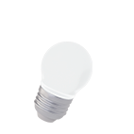
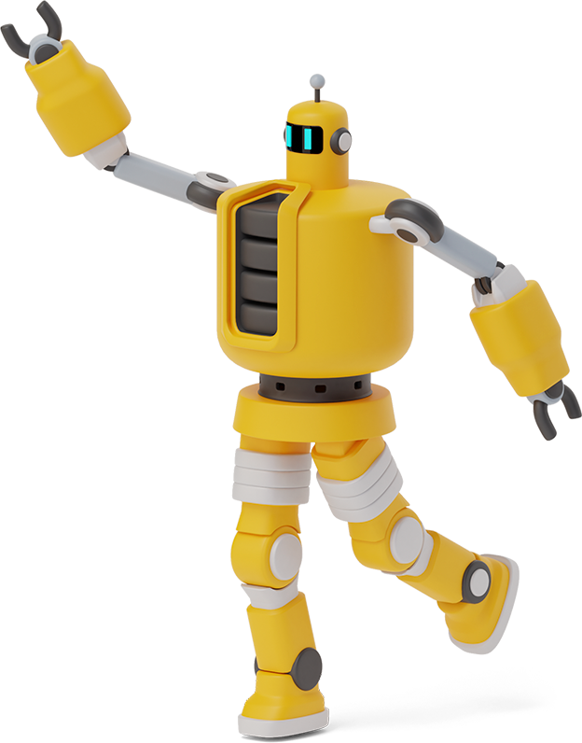
eletronics project report 2022
arduino based MULTI-FUNCTIONAL robot
LINE FOLLOWER,OBSTACLE AVOIDING,VOICE CONTROL,
REMOTE CONTROL,ANDROID APPLICATION ROBOT
TEAM MEMBERS:-
1) GUPTA SURAJ RAMSEVAK (09)
2) BHAGWAT SANTOSH SHELKE (30)
MENTOR :- HOD OF ELCTRONICS DEP.
1)PROF.SMT.S.K.JADHAV PROF.S.S.DEMSE
2) PROF.SMT.S.K.KULKARNI

Slide 2
COMPONENTS
ARDUINO UNO R3
VS1838 IR RECEIVER MODULE
1
6
ULTRASONIC SENSOR
2
IR TRANSMITTER REMOTE
7
BLUTOOTH MODULE HC-05
3
BREADBOARD
8
200 RPM BO MOTORS AND WHEELS
12V LI-ION BATTERY
4
9
L298N MOTOR DRIVER SHIELD
5

Slide 3
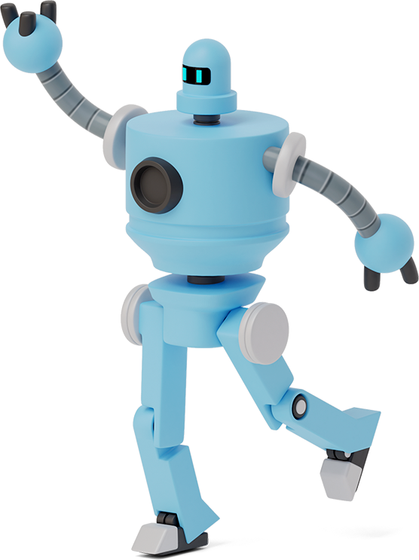
INTRODUCTION
Previous sem we made a obstacle avoiding robot and we have seen that there were many types of robots is their line follower ,blutooth control etc. Then we got an idea that lets make it a Multi-functional robot. The Multi-functional robot is design to work as a O.A to avoid the obstcle in its path, L.F Follow the Track only, B.C Control the Robot Through Mobile Application , V.C Follow the instruction through voice and Remote Control Robot. In this robot we have used some sensors,BO motors, motor drivers etc. The construction of the robot is very easy and the base of the robot is made by PVC Sheet. The main component behind this robot is Arduino Uno (ATmega328p IC) microcontroller which is brain of this robot.

Slide 4
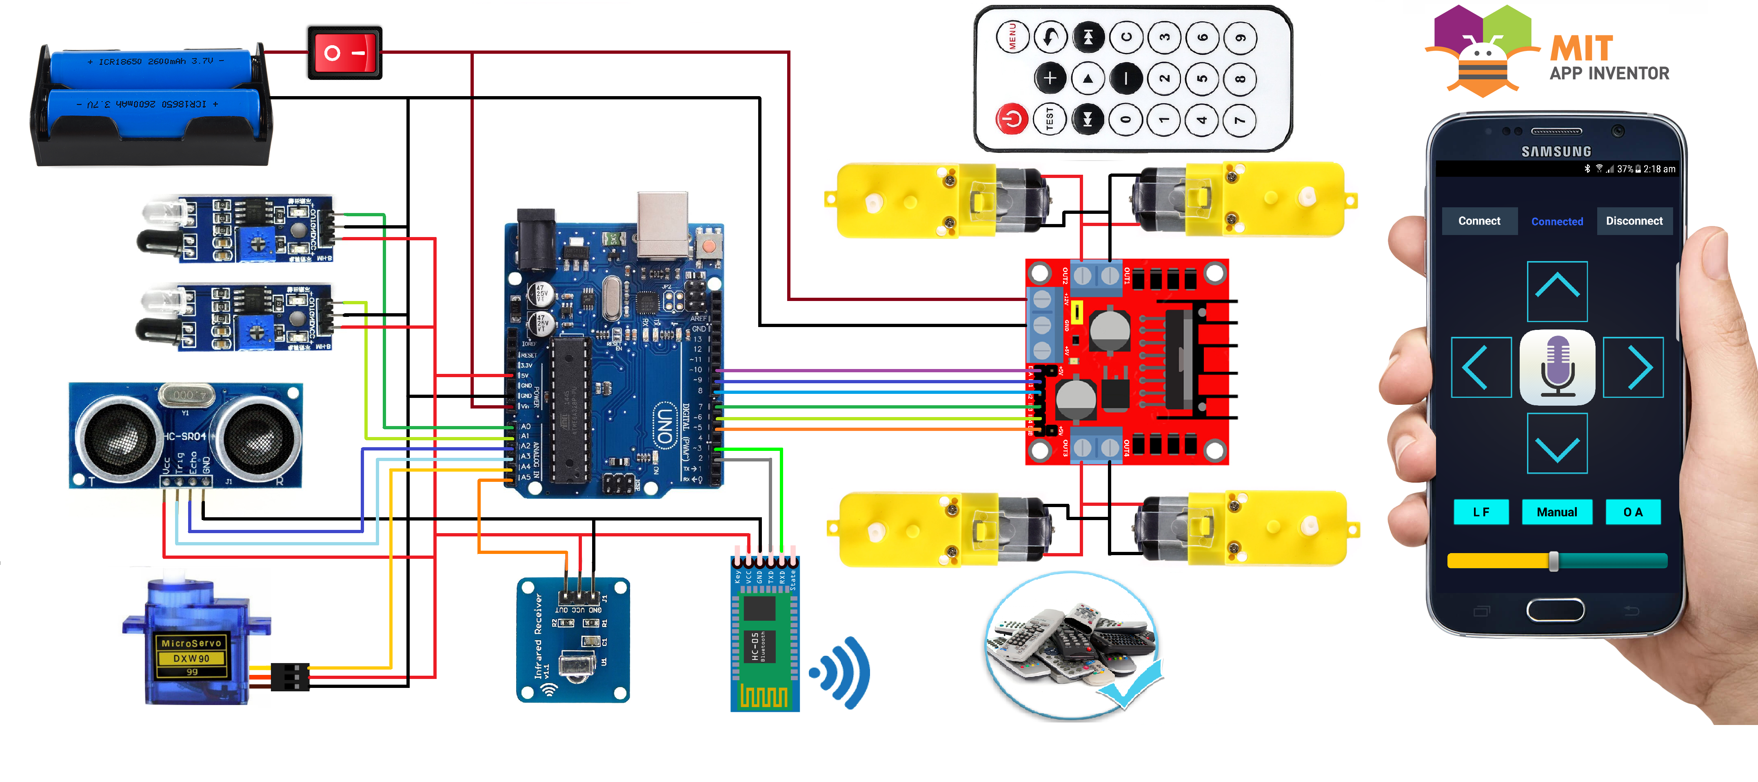
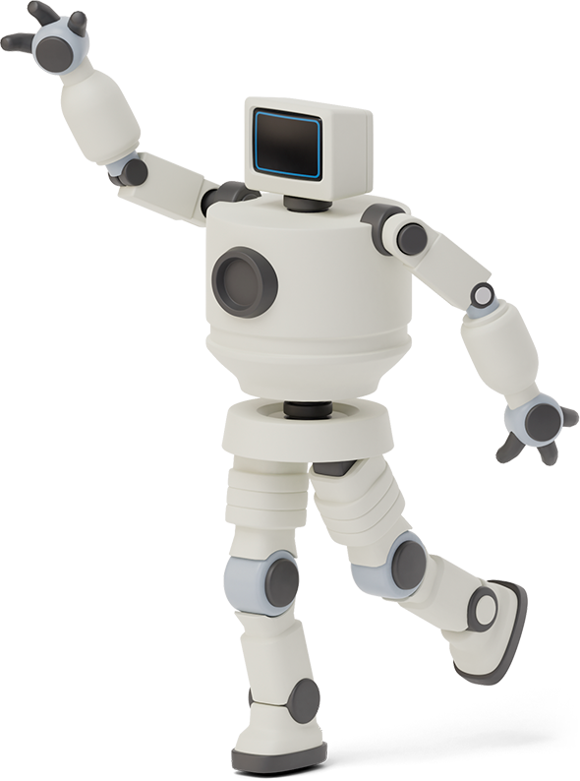

SCHEMATICS

Slide 5
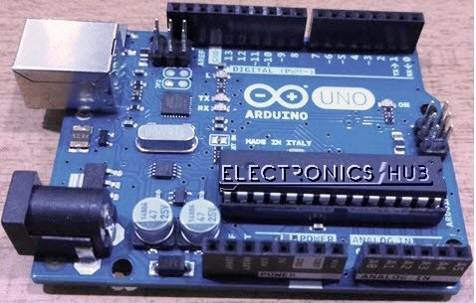
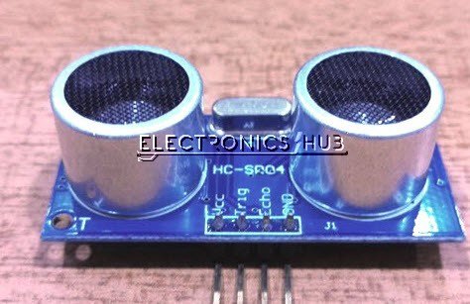
COMPONENT DISCRIPTION
ARDUINO UNO R3:-
Arduino Uno is an ATmega 328p Microcontroller based prototyping board. It is an open source electronic prototyping platform that can be used with various sensors and actutaors. Arduino Uno has 14 digital I/O pins and 5 Analog pins
ULTRASONIC SENSOR:-
It is an Ultrasonic Range Finder Sensor. It is non-contact based distance measurement system and can measure of 50cm to 60cm.

Slide 6
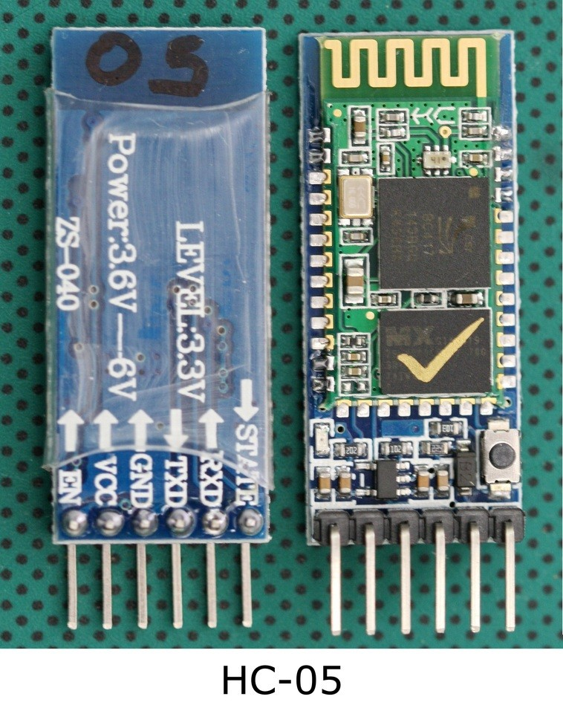
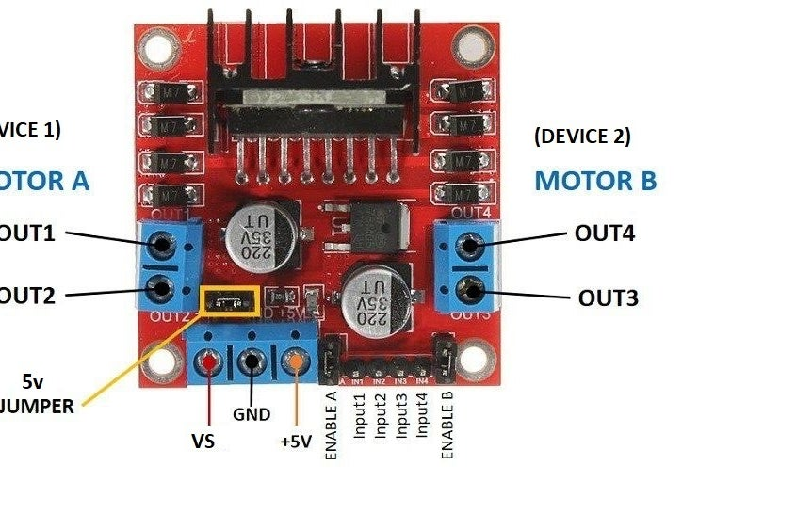
COMPONENT DISCRIPTION
L298N MOTOR DRIVER:-
The L298N is a dual-channel H-Bridge motor driver capable of driving two DC motors and one stepper motor. means it can individually drive up to two DC motor for any applications like 4WD robots, Small drill machine, solenoid valve, DC lock etc.
An L298N motor driver module consists of an L298N motor driver chip(IC). which is an integrated monolithic circuit in a 15-lead Multiwatt package. It is a high voltage, a high current dual full-bridge driver designed to accept standard TTL logic levels. For more details the datasheet given to the below link.
BLUTOOTH MODULE HC-05:-
HC-05 Bluetooth Module is an easy to use Bluetooth SPP (Serial Port Protocol) module, designed for transparent wireless serial connection setup. It has 6 pins
EN (enable),VCC,GND,TXD,RXD & STATE.

Slide 7
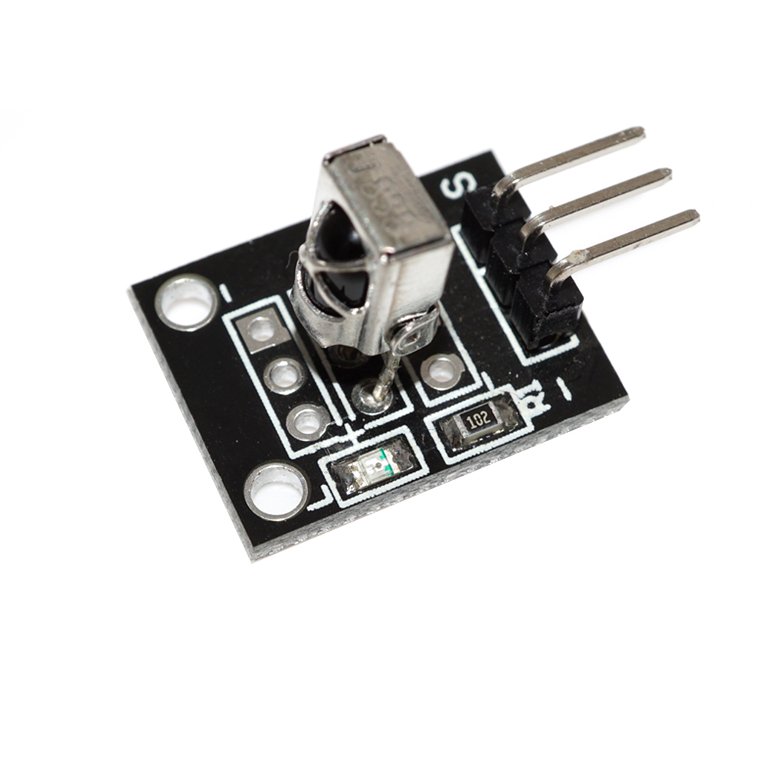
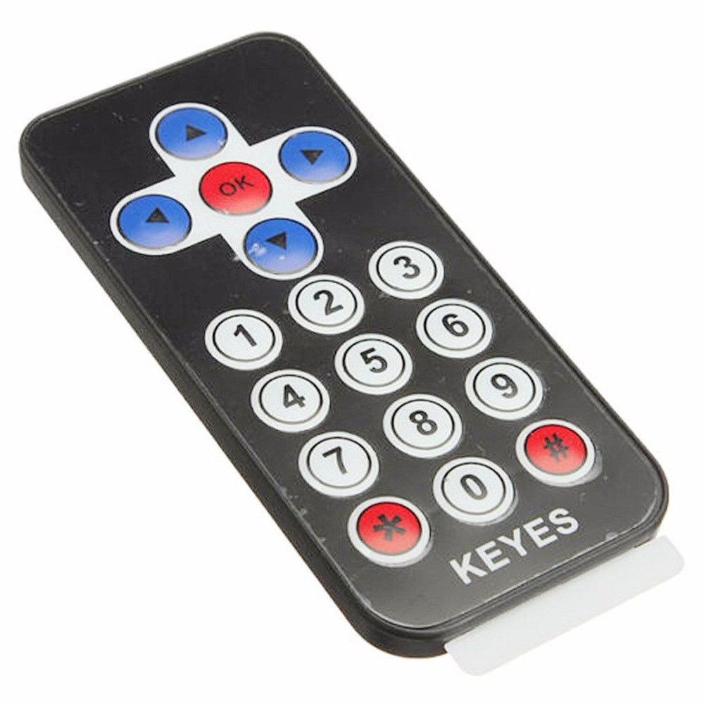
COMPONENT DISCRIPTION
VS1838 IR RECEIVER:-
It has three pinouts. Pin 1 is the ‘out’ pin which gives the sequence depending on the IR signal that has been detected. Pin 2 is the ground pin, which is connected to the ground of the circuit and pin 3 is the VCC pin which connects to the 5.5V, 2.5V and +5V.
IR TRANSMITTER REMOTE:-
A remote control flashes a pattern of invisible light, which is picked up and then turned into an instruction by the receiver module

Slide 8
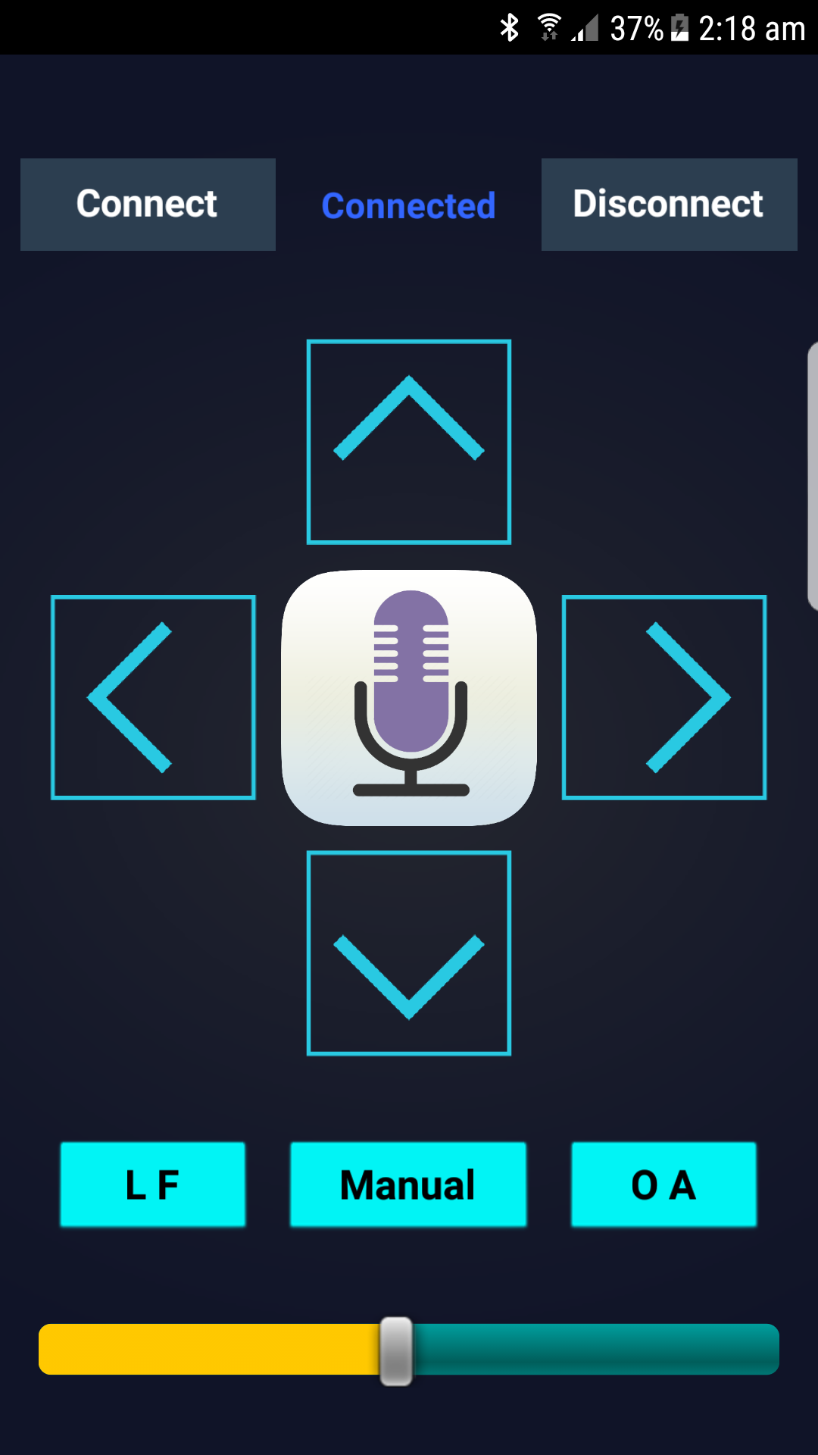
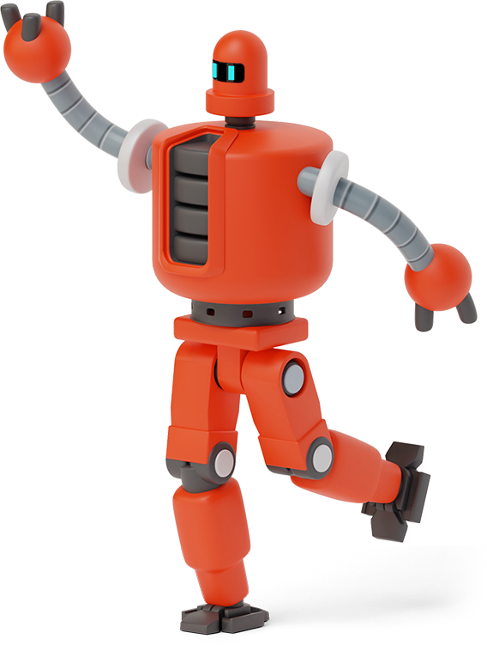
Architecture and Block for Android Application

Slide 9
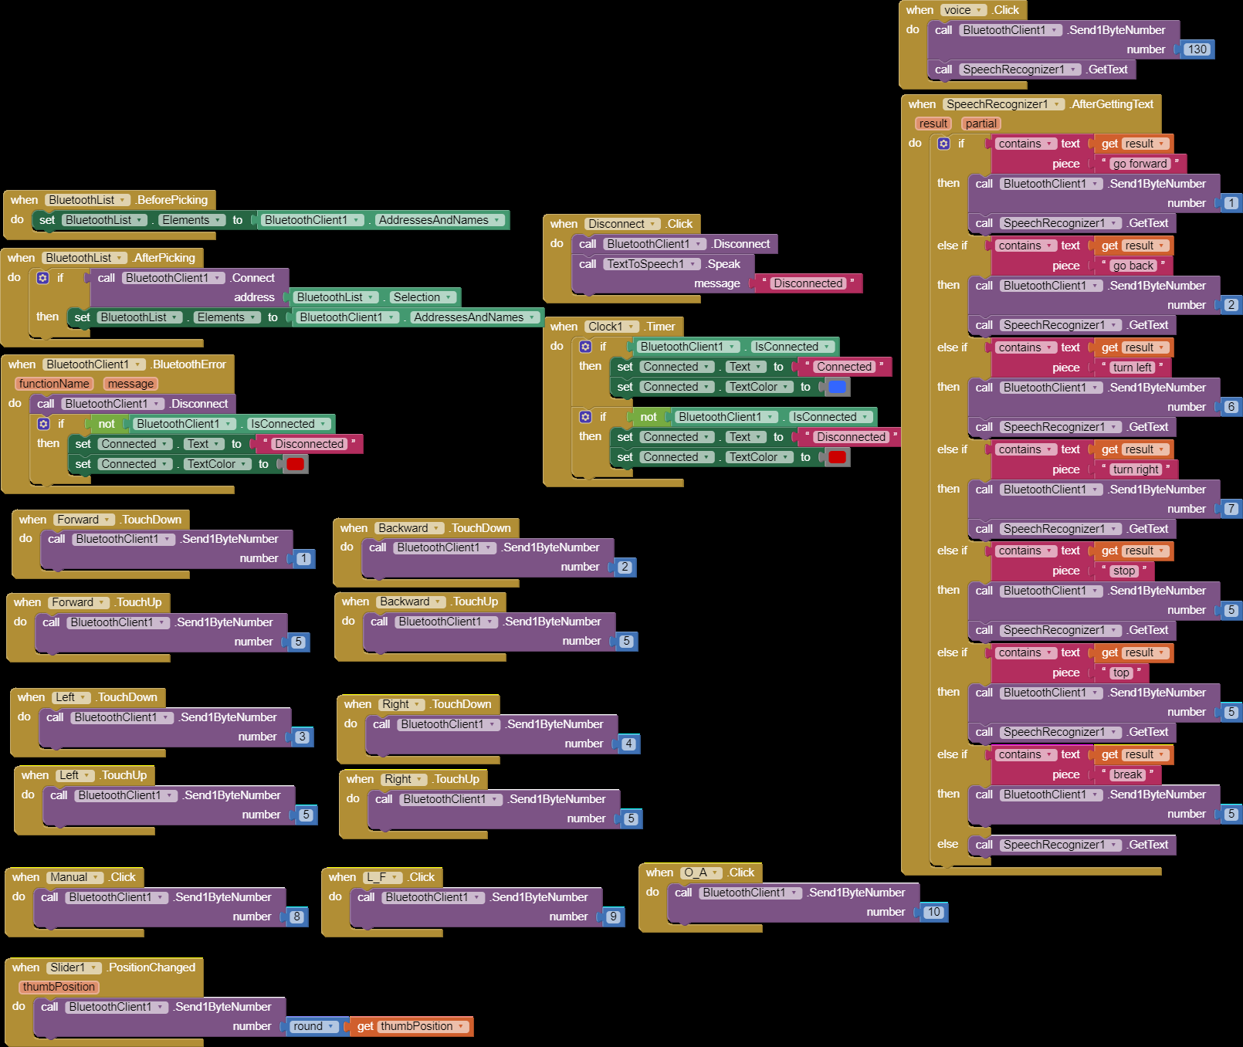

Slide 10
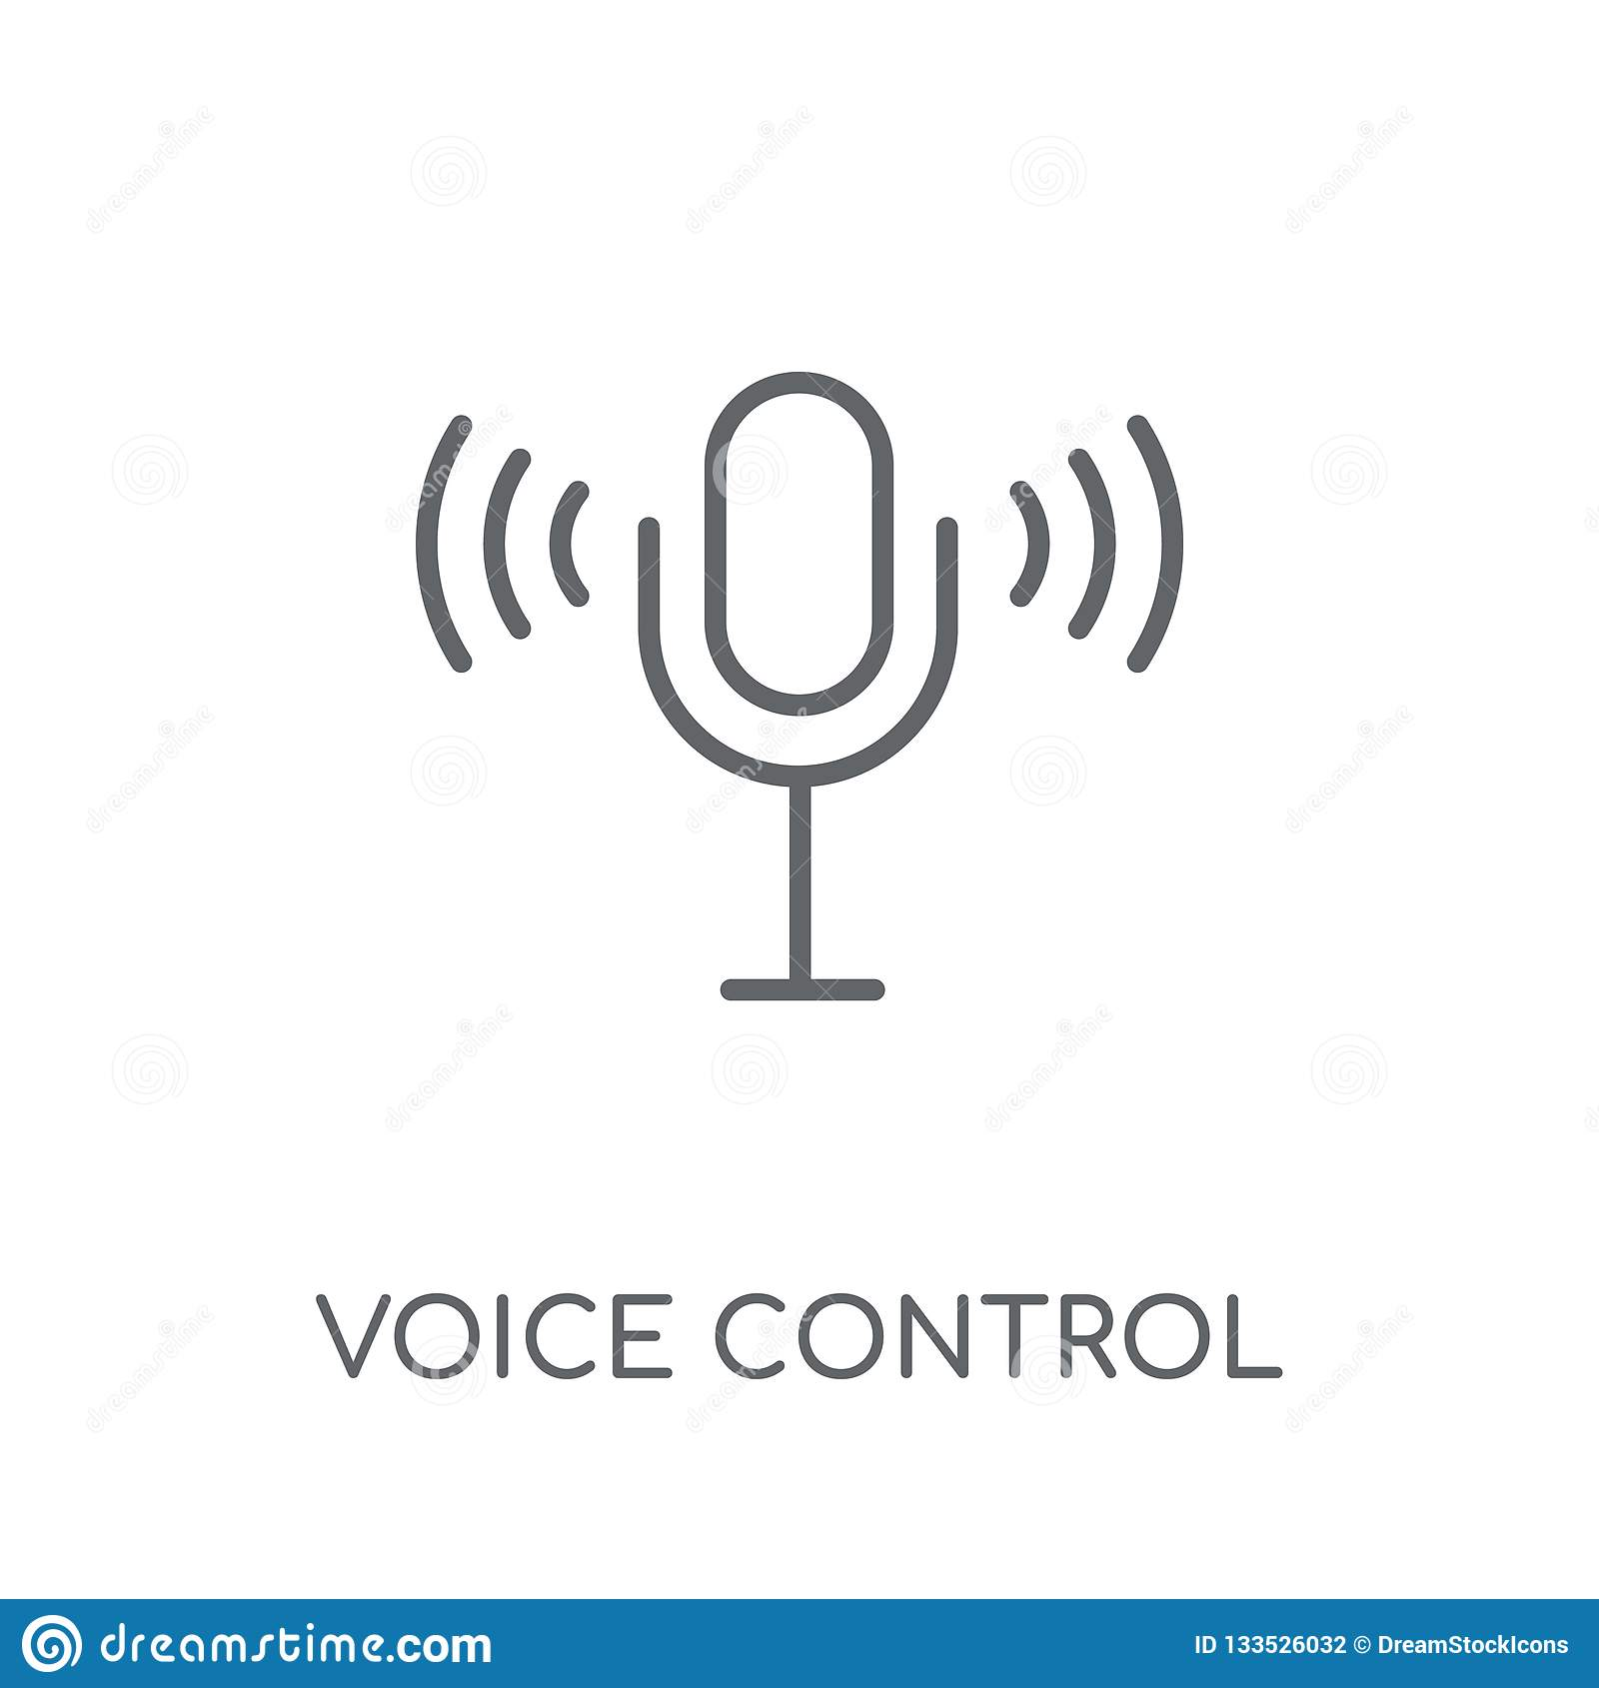
SEND 1
WORKING FLOWCHART
SEND 1
GO FORWARD
ARDUINO
START
SEND 2
GO BACK
SEND 2
SEND 1BYTE NUMBER
SEND 1BYTE NUMBER
BLUTOOTH CONTROL APP
SEND 6
TURN LEFT
MIDDLE BLOCKS
connect HC-05
SEND 130
VOICE SPEECH
SEND 3
SEND 7
TURN RIGHT
SEND 8
LOWER BLOCKS
SEND 10
MANUAL
O.B
SEND 5
STOP
SEND4
SEND 9
L.F

Slide 11
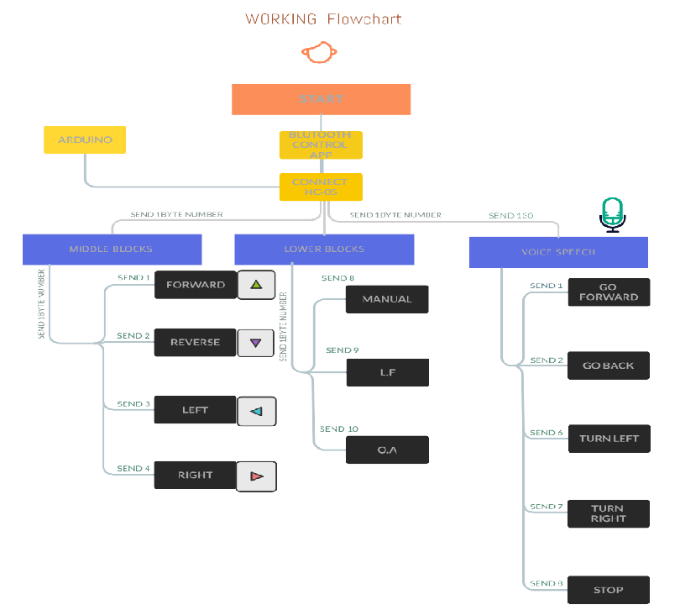

Slide 12
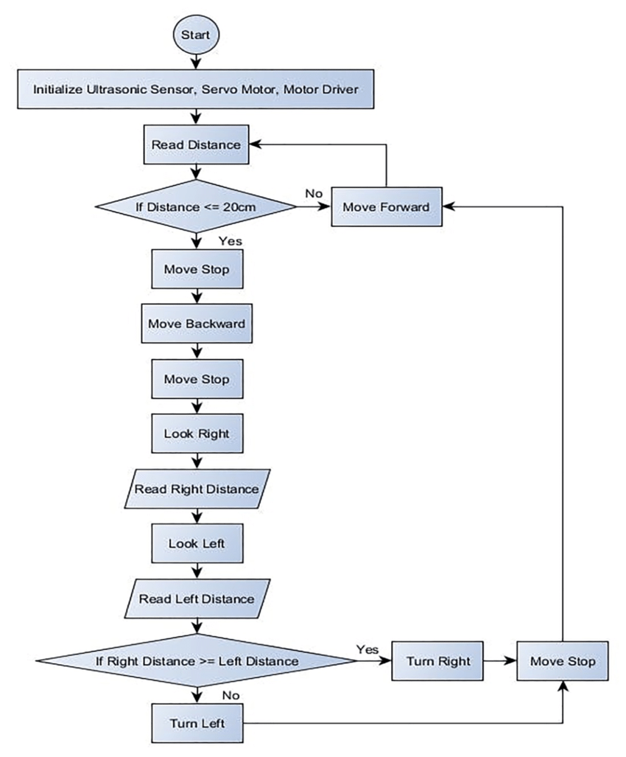
obstacle avoiding working flowchart

Slide 13
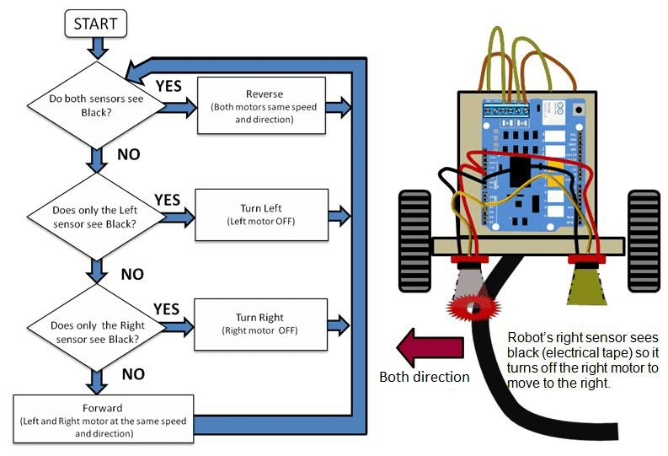
Line Follower Working Flowchart

Slide 14
PROGRAM :
void setup(){ // put your setup code here, to run once
pinMode(R_S, INPUT); // declare if sensor as input
pinMode(L_S, INPUT); // declare ir sensor as input
pinMode(echo, INPUT );// declare ultrasonic sensor Echo pin as input
pinMode(trigger, OUTPUT); // declare ultrasonic sensor Trigger pin as Output
pinMode(enA, OUTPUT); // declare as output for L298 Pin enA
pinMode(in1, OUTPUT); // declare as output for L298 Pin in1
pinMode(in2, OUTPUT); // declare as output for L298 Pin in2
pinMode(in3, OUTPUT); // declare as output for L298 Pin in3
pinMode(in4, OUTPUT); // declare as output for L298 Pin in4
pinMode(enB, OUTPUT); // declare as output for L298 Pin enB
irrecv.enableIRIn(); // Start the receiver
irrecv.blink13(true);
Serial.begin(9600); // start serial communication at 9600bps
BT_Serial.begin(9600);
pinMode(servo, OUTPUT);
for (int angle = 70; angle <= 140; angle += 5) {
servoPulse(servo, angle); }
for (int angle = 140; angle >= 0; angle -= 5) {
servoPulse(servo, angle); }
for (int angle = 0; angle <= 70; angle += 5) {
servoPulse(servo, angle); }
delay(500);
}
#include <SoftwareSerial.h>
SoftwareSerial BT_Serial(2, 3); // RX, TX
#include <IRremote.h>
const int RECV_PIN = A5;
IRrecv irrecv(RECV_PIN);
decode_results results;
#define enA 10//Enable1 L298 Pin enA
#define in1 9 //Motor1 L298 Pin in1
#define in2 8 //Motor1 L298 Pin in1
#define in3 7 //Motor2 L298 Pin in1
#define in4 6 //Motor2 L298 Pin in1
#define enB 5 //Enable2 L298 Pin enB
#define servo A4
#define R_S A0 //ir sensor Right
#define L_S A1 //ir sensor Left
#define echo A2 //Echo pin
#define trigger A3 //Trigger pin
int distance_L, distance_F = 30, distance_R;
long distance;
int set = 20;
int bt_ir_data; // variable to receive data from the serial port and IRremote
int Speed = 80;
int mode=0;
int IR_data;

Slide 15
void loop(){
if(BT_Serial.available() > 0){ //if some date is sent, reads it and saves in state
bt_ir_data = BT_Serial.read();
Serial.println(bt_ir_data);
if(bt_ir_data > 20){Speed = bt_ir_data;}
}
if (irrecv.decode(&results)) {
Serial.println(results.value,HEX);
bt_ir_data = IRremote_data();
Serial.println(bt_ir_data);
irrecv.resume(); // Receive the next value
delay(100);
}
if(bt_ir_data == 8){mode=0; Stop();} //Manual Android Application and IR
Remote Control Command
else if(bt_ir_data == 9){mode=1; Speed=60;} //Auto Line Follower Command
else if(bt_ir_data ==10){mode=2; Speed=60;} //Auto Obstacle Avoiding Command
analogWrite(enA, Speed); // Write The Duty Cycle 0 to 255 Enable Pin A for Motor1
Speed
analogWrite(enB, Speed); // Write The Duty Cycle 0 to 255 Enable Pin B for Motor2
Speed
if(mode==0){
//===============================================================================
// Key Control Command
//===============================================================================
if(bt_ir_data == 1){forword(); } // if the bt_data is '1' the DC motor will go
forward
else if(bt_ir_data == 2){backword();} // if the bt_data is '2' the motor will
Reverse
else if(bt_ir_data == 3){turnLeft();} // if the bt_data is '3' the motor will turn
left
else if(bt_ir_data == 4){turnRight();} // if the bt_data is '4' the motor will turn
right
else if(bt_ir_data == 5){Stop(); } // if the bt_data '5' the motor will Stop
//===============================================================================
// Voice Control Command
//===============================================================================
else if(bt_ir_data == 6){turnLeft(); delay(600); bt_ir_data = 5;}
else if(bt_ir_data == 7){turnRight(); delay(600); bt_ir_data = 5;}
}
if(mode==1){
//===============================================================================
// Line Follower Control
//===============================================================================
if((digitalRead(R_S) == 0)&&(digitalRead(L_S) == 0)){forword();} //if Right Sensor
and Left Sensor are at White color then it will call forword function
if((digitalRead(R_S) == 1)&&(digitalRead(L_S) == 0)){turnRight();}//if Right Sensor
is Black and Left Sensor is White then it will call turn Right function
if((digitalRead(R_S) == 0)&&(digitalRead(L_S) == 1)){turnLeft();} //if Right Sensor
is White and Left Sensor is Black then it will call turn Left function
if((digitalRead(R_S) == 1)&&(digitalRead(L_S) == 1)){Stop();} //if Right Sensor
and Left Sensor are at Black color then it will call Stop function
}
if(mode==2){
//===============================================================================
// Obstacle Avoiding Control
//===============================================================================
distance_F = Ultrasonic_read();
Serial.print("S=");Serial.println(distance_F);
if (distance_F > set){forword();}
else{Check_side();}
}
delay(10);
}

Slide 16
long IRremote_data(){
if(results.value==0xFF18E7){IR_data=1;}
else if(results.value==0xFF4AB5){IR_data=2;}
else if(results.value==0xFF5AA5){IR_data=3;}
else if(results.value==0xFF10EF){IR_data=4;}
else if(results.value==0xFF38C7 || results.value==0xFF9867){IR_data=5;}
else if(results.value==0xFFA25D){IR_data=8;}
else if(results.value==0xFF629D){IR_data=9;}
else if(results.value==0xFFE21D){IR_data=10;}
return IR_data;
}
void servoPulse (int pin, int angle){
int pwm = (angle*11) + 500; // Convert angle to microseconds
digitalWrite(pin, HIGH);
delayMicroseconds(pwm);
digitalWrite(pin, LOW);
delay(50); // Refresh cycle of servo
}
//**********************Ultrasonic_read****************************
long Ultrasonic_read(){
digitalWrite(trigger, LOW);
delayMicroseconds(2);
digitalWrite(trigger, HIGH);
delayMicroseconds(10);
distance = pulseIn (echo, HIGH);
return distance / 29 / 2;
}
void compareDistance(){
if (distance_L > distance_R){
turnLeft();
delay(350);
}
else if (distance_R > distance_L){
turnRight();
delay(350);
}
else{
backword();
delay(300);
turnRight();
delay(600);
}
}
void Check_side(){
Stop();
delay(100);
for (int angle = 70; angle <= 140; angle += 5) {
servoPulse(servo, angle); }
delay(300);
distance_L = Ultrasonic_read();
delay(100);
for (int angle = 140; angle >= 0; angle -= 5) {
servoPulse(servo, angle); }
delay(500);
distance_R = Ultrasonic_read();
delay(100);
for (int angle = 0; angle <= 70; angle += 5) {
servoPulse(servo, angle); }
delay(300);
compareDistance();
}
void forword(){ //forword
digitalWrite(in1, HIGH); //Right Motor forword Pin
digitalWrite(in2, LOW); //Right Motor backword Pin
digitalWrite(in3, LOW); //Left Motor backword Pin
digitalWrite(in4, HIGH); //Left Motor forword Pin
}

Slide 17
void backword(){ //backword
digitalWrite(in1, LOW); //Right Motor forword Pin
digitalWrite(in2, HIGH); //Right Motor backword Pin
digitalWrite(in3, HIGH); //Left Motor backword Pin
digitalWrite(in4, LOW); //Left Motor forword Pin
}
void turnRight(){ //turnRight
digitalWrite(in1, LOW); //Right Motor forword Pin
digitalWrite(in2, HIGH); //Right Motor backword Pin
digitalWrite(in3, LOW); //Left Motor backword Pin
digitalWrite(in4, HIGH); //Left Motor forword Pin
}
void turnLeft(){ //turnLeft
digitalWrite(in1, HIGH); //Right Motor forword Pin
digitalWrite(in2, LOW); //Right Motor backword Pin
digitalWrite(in3, HIGH); //Left Motor backword Pin
digitalWrite(in4, LOW); //Left Motor forword Pin
}
void Stop(){ //stop
digitalWrite(in1, LOW); //Right Motor forword Pin
digitalWrite(in2, LOW); //Right Motor backword Pin
digitalWrite(in3, LOW); //Left Motor backword Pin
digitalWrite(in4, LOW); //Left Motor forword Pin
}

Slide 18
APPLICATIONS
IT IS USED IN HOUSEHOLD WORK SUCH AS VACCUM CLEANER
IT IS USED IN DANGEROUS ENVIRONMENT ,WHERE HUMAN PENETRAION COULD SYSTEMS.
IT IS USED IN VERIOUS INDUSTRAL AND DOMESTIC APPLICATION SUCH AS TO CARRYBGOODS, FLOOR CLEANING , DELIVERY SERVICES AND TRANSPORTATION
IT IS USED IN ALMOST ALL MOBILE ROBOT NAVIGATION SYSTEM

Slide 19

Thanks!

